Slide 1
CSE-311: Microprocessors AND Assembly Language
(3 Credits)
A.H.M. Asadul Huq, Ph.D.
Professor
Dept. of EEE, University of Dhaka
Get course materials from the following link
http://asadul.drivehq.com/students.htm
Note: The password: cse.uap@univdhaka.edu

Slide 2
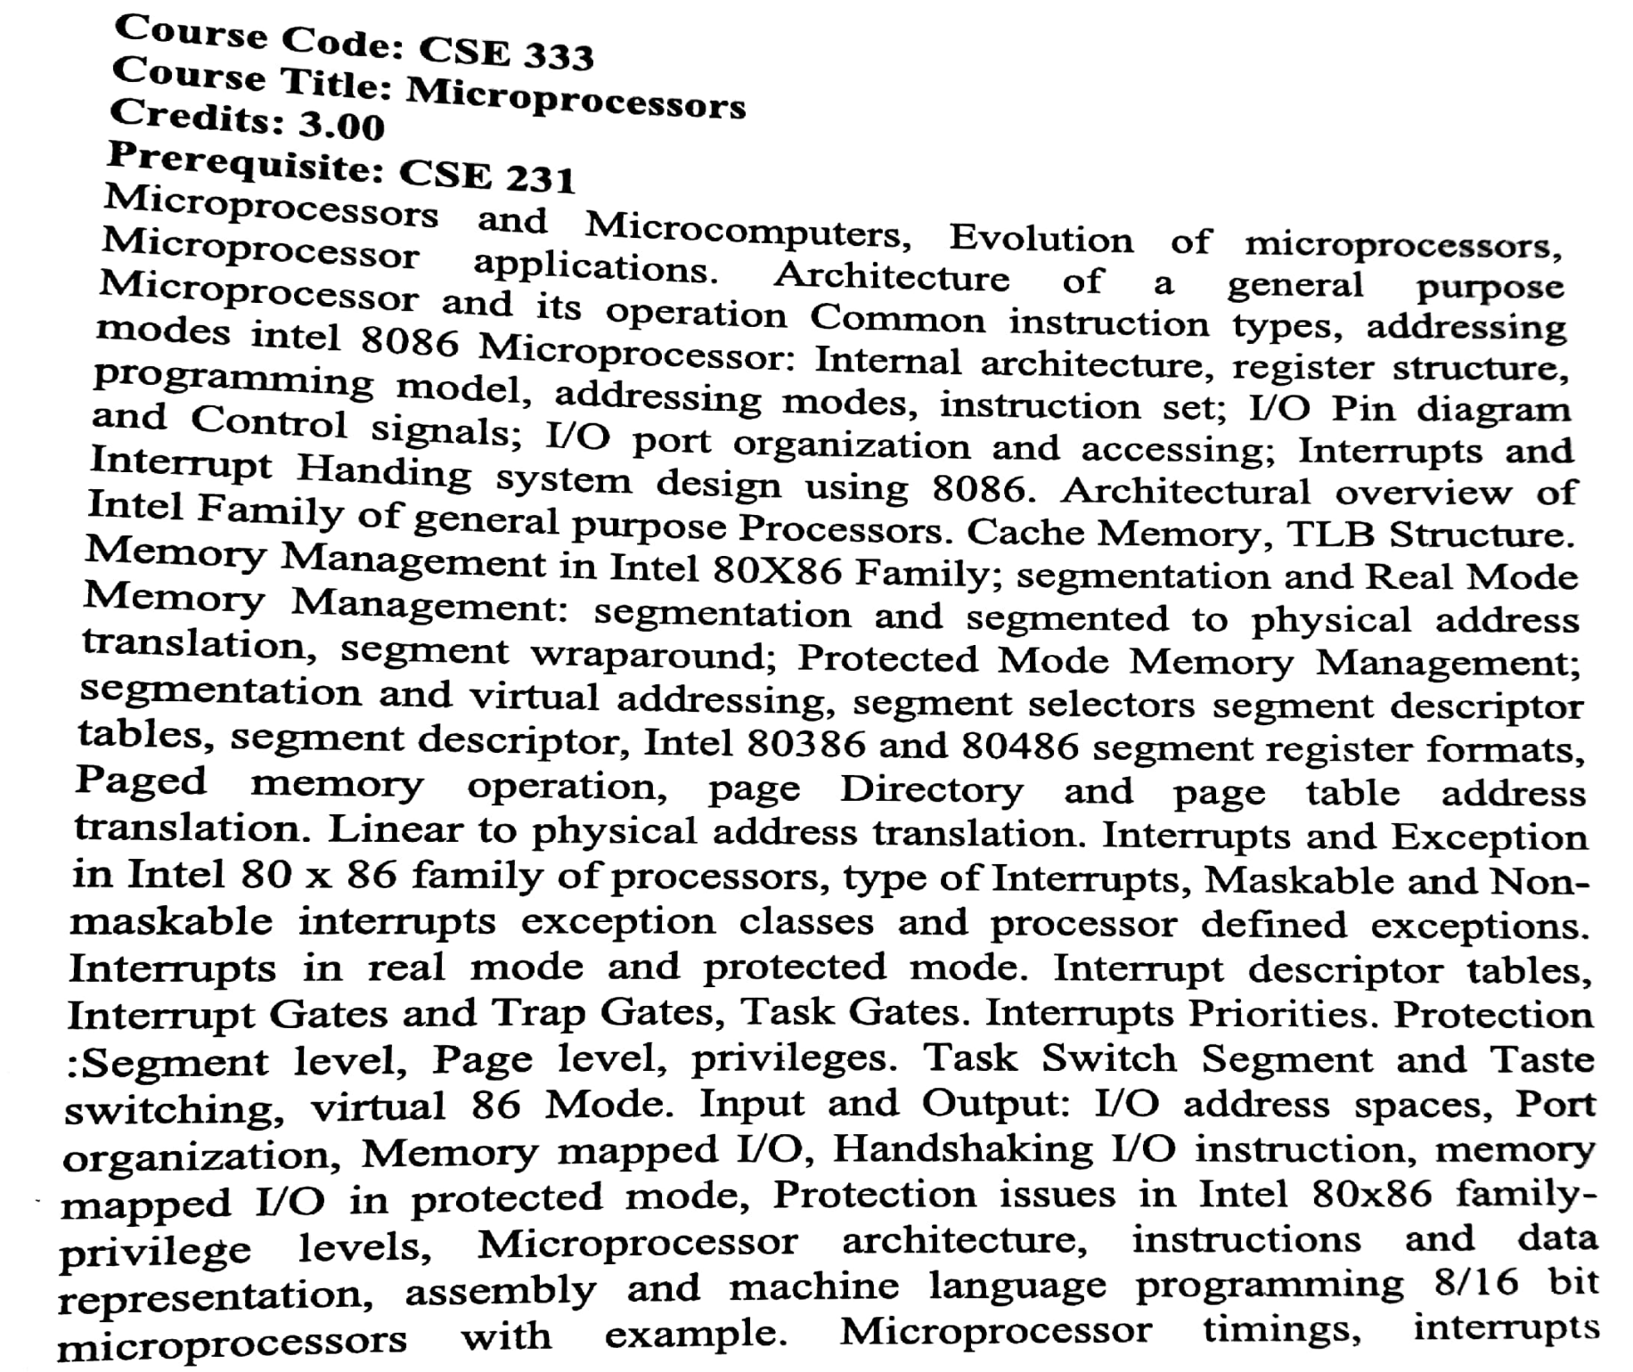
Syllabus:

Slide 3
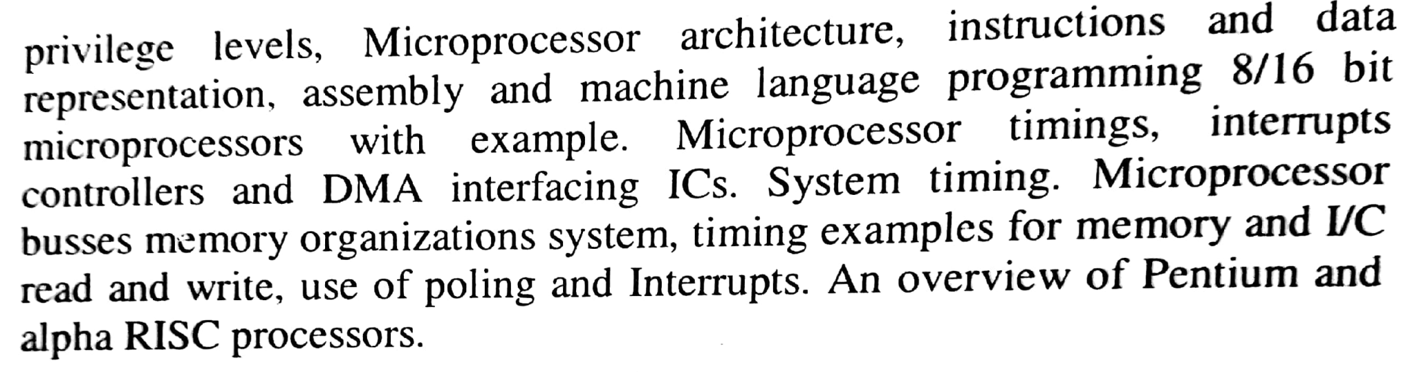
Continued..

Slide 4
REFERENCE BOOKS
Microprocessor X86 Programming. Author: K. R. Venugopal, and Raj Kumar
The Intel Microprocessors: 8086/8088, 80186/80188, 80286, 80386, 80486, Pentium, Pentium Pro Processor, Pentium II, Pentium III, Pentium 4, and Core2 with 64-bit Extensions: Architecture, Programming, and Interfacing. Author: Barry B Brey
Microprocessors and Microcomputer Based System Design. Author: Mohamed Rafiquzzaman
Microprocessors Theory and Applications Intel and Motorola. Author: M. Rafiquzzaman
Microcomputer Systems: The 8086/8088 Family Architecture, Programming and Design. Authors: Yu-cheng Liu, and Glenn A. Gibson
Assembly Language Programming and Organization of the IBM PC Authors: Yu and Marut

Slide 5
Microprocessor and Microcomputer
Microcomputer:
It is a small, relatively inexpensive computer .
It includes a microprocessor as central processing unit (CPU), memory unit, and input/output (I/O) unit mounted on a single printed circuit board.
It became popular in the 1970s and 1980s with the advent of increasingly powerful microprocessors.
Microprocessor:
CPU of a microcomputer/ personal computer is known as microprocessor.

Slide 6
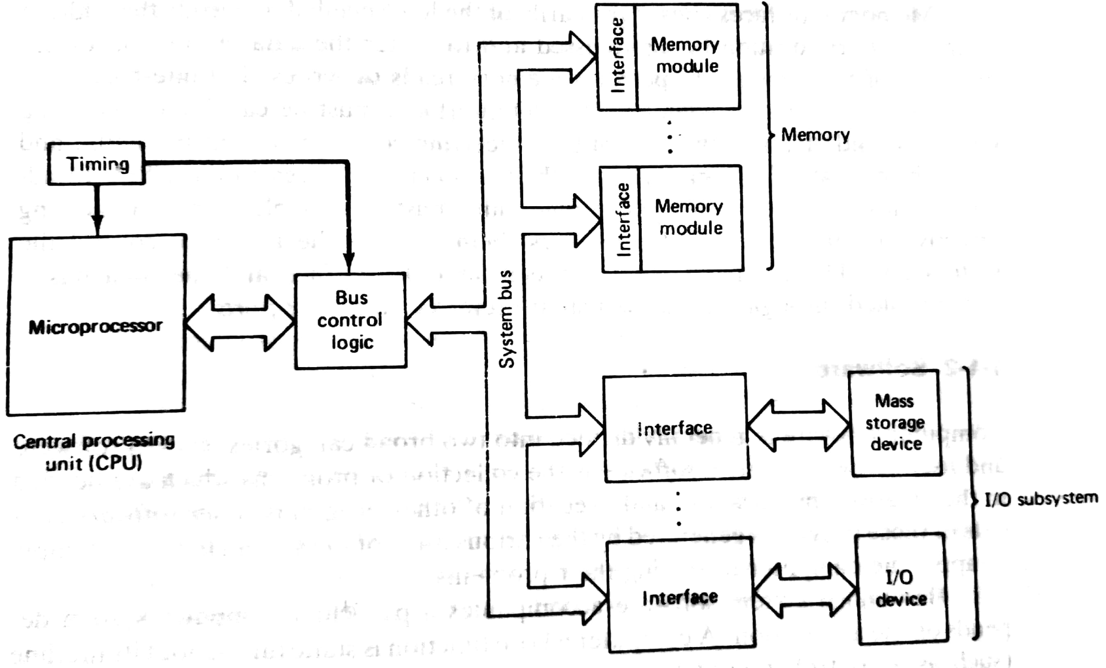
Typical Microcomputer System Block diagram
Fig. 1-1 (Liu and Gibson): Architecture of a typical microcomputer

Slide 7
Components of a typical Microcomputer
CPU (Microprocessor)
Timing circuitry-This circuit generates different pulse train to synchronize the activity within the µP and the bus control logic.
Memory modules
INPUT/OUTPUT (I/O) subsystem
BUS control logic
System BUS

Slide 8
Historical Background
1947: Invention of Transistor
1959: Invention of Integrated Circuit (IC)
1965: Birth of Moore’s Law
(Prediction: Rate of progress of IC)
Example: IC (1965)—32 Transistors
IC(1966) —64 Transistors
etc.
1971: Development of First Microprocessor (Intel: 4004)
1976: Introduction of First Microcontroller (Intel: 8048)

Slide 9
Evolution of IC Technology
Year | Technology | No. of Devices | Typical Products
1947 | Invention of Transistor | 1
1950-1960 | Discrete Components | 1 | Junction Diode and Transistor
1961-1965 | SSI | 10-100 | Logic gates, FFs
1966-1970 | MSI | 100-1000 | Counter, MUX/DEMUX, Decoder
1971-1979 | LSI | 1000-20000 | 8-bit µP, RAM, ROM
1980-1984 | VLSI | 20,000-50,000 | DSP IC, RISC 16-bit, 32-bit µP
1985- | ULSI | >50,000 | 64-bit µP

Slide 10
Evolution of Microprocessors
General purpose microprocessor
1971: 4004 (Intel µP, 4-bit)
8008 (8-bit)
8080
1986: 8085 (8-bit) 8048 (µC)
8086 (16-bit) 8051
8088 8096
80186
80286
80386 (32-bit, 1985)
(80386EX (32-bit, 1995): Embedded PC/System)
80486 (32-bit, on chip cache memory)
Pentium-I, II, III, IV (32-bit)
RISC
Pentium core ix etc. (64-bit, superscalar processor)

Slide 11
Evolution of Microprocessors Continued …
Processor Year of No. of Transistor
Introduction
4004 1971 2250
8008 1972 2500
8080 1974 5000
8086 1978 29000
80186 1982 120,000
80286 1982 150,000
80386 1985 275,000
80486 1989 11,80,000
Pentium-I 1993 31,00,000
Pentium-II 1997 7,500,000
Pentium-III 1999 2,40,00,000
Pentium-IV 2000 4,20,00,000

Slide 12
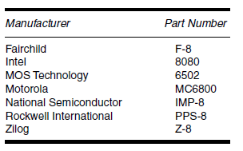
Special Purpose Processing
DSP 2920
TMS 320
NEC µPD7720
Communication Processor
IXP7XX , such as IXP750
(Intel Com Processor:
it is used for packet processing, switching, routing etc.)
Early 8-bit microprocessors:

Slide 13
Processor Comparison
Attributes | 4004 | 8008 | 8080 | 8085 5 volt single supply | 8086 | 8088 | 80286
Year | 1971 | 1972 | 1974 | 1976 | 1978 | 1989 | 1982
Transistors | 2,300 | 3,300 | 4,500 | 6500 | 29,000 |  | 134,000
Word Size | 4-bit | 8-bit | 8-bit | 8-bit | 16-bit | 16-bit | 16-bit
Address Size | 12-bit | 14-bit | 16-bit | 16-bit | 20-bit | 20-bit | 24-bit
Addressable Memory | 4 KB | 16 KB | 64 KB | 64 KB | 1 MB | 1 MB | 16 MB
Instructions | 46 | 48 | 72 | 74 or 80 | 133 |  | 133+
Max Frequency | 740.74 KHz | 800 KHz | 2 MHz | 5 MHz | 10 MHz | 10 MHz | 12 MHz

Slide 14
Typical Features of Microprocessors
Smaller size
Lower cost
Higher reliability
Low power consumption
Higher flexibility
More powerful

Slide 15
Typical Applications of Microprocessor
Desktop, PCs, Laptops, Workstations, Servers, Super computer
Microcontroller-Embedded systems
(Design for a specific application)
Consumer electronics—Toys, cameras, Robots
Washing machine, Microwave oven,
Intelligent Instrument—Oscilloscope, Spectrum/ Logic analyzer
Medical Instrument, Process control, data acquisition etc.
Communications---Telephone set, answering machine, Cordless phone
Office equipments-FAX machine, Printers, PABX
Multimedia applications—PDA, Teleconference equipments, cell phone etc.

Slide 16
Applications of special processor
DSP processor
Switches
Router
Math Co-processor

Slide 17
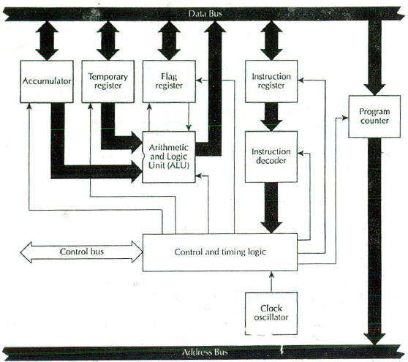
Typical Architecture of a INTEL 8085 Microprocessor

Slide 18
Intel 8085 Features
Processor: 8-bit NMOS 40 PIN
Power supply: +5V
Clock speed: 3.03 MHz (8085A), and 5 MHz (8085A-2)
Pin: 40 pin IC
Design: using NMOS technology
Data bus: 8-bit (Hence 8085 is 8-bit processor, since 8 bits of data can be transmitted in parallel)
Address bus: 16-bit (address up to 64KB)
Registers: 6 General Purpose (B, C, D, E, H & L) and 4 Special Purpose (ACCUMULATOR, FLAG, Program Counter & Stack Pointer)

Slide 19
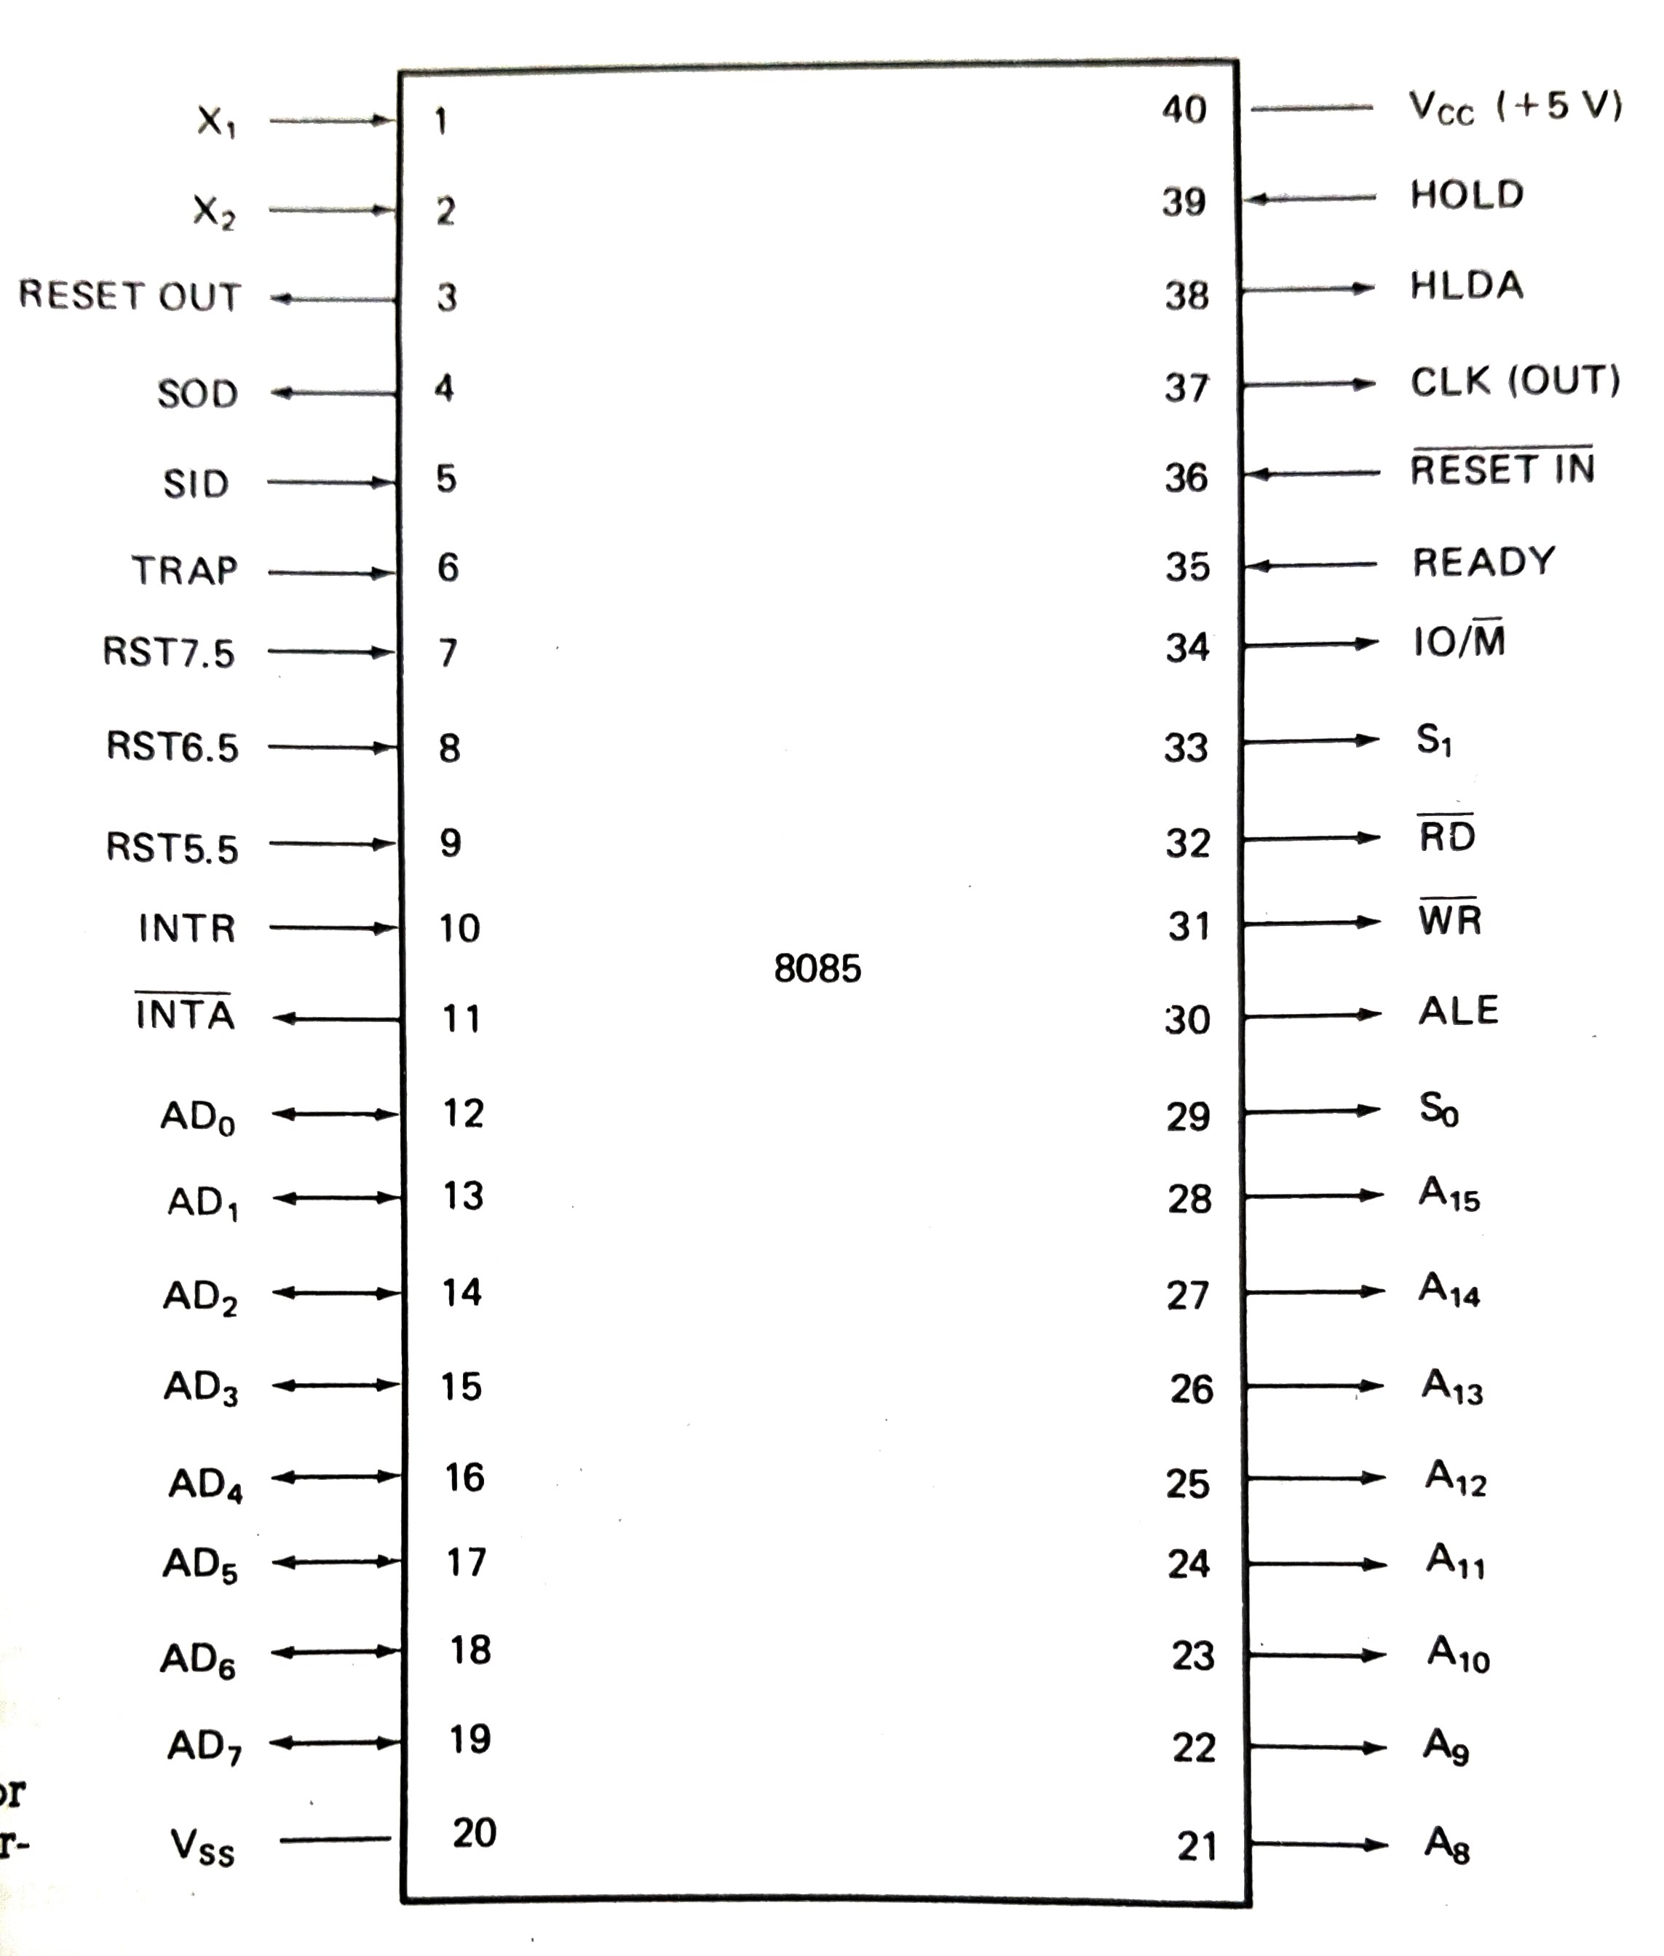
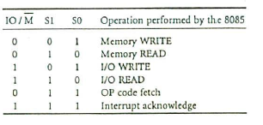
Pin Configuration of 8085
Fig. 4-3 (Rafiquzzaman B-3) 8085 Pin Configuration

Slide 20
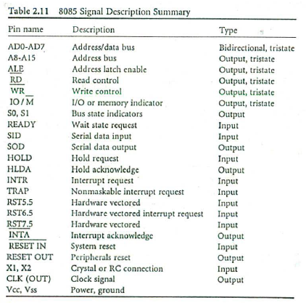

Slide 21
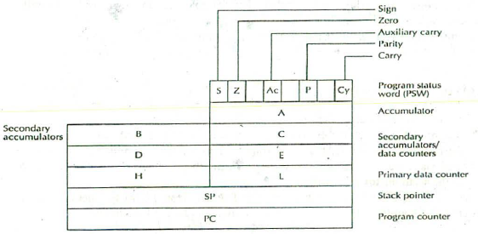
8085 µP Registers
8085 has 6 general purpose registers: B, C, D, E, H, and L
And 4 Specific Purpose Registers: Accumulator, Program Status
Word (Flag), Program Counter and Stack Pointer

Slide 22
Typical Instruction Sets of a Microprocessor
Types of Instruction
Data transfer instructions (MOV)
Arithmetic instructions (ADD)
Logical instructions (AND)
Program control instructions (JMP)
I/O instructions (IN/OUT)

Slide 23
Microprocessors Vol-1
THE END
A.H.M. Asadul Huq, Ph.D.
Professor
Dept. of EEE, University of Dhaka

